Slide 1
‹#›

Slide 2

APPLIED CRYPTOGRAPHY
Lecture 47
‹#›

Slide 3
Digital signature
How to sign a digital document?
‹#›

Slide 4
Contents
To define a digital signature
To define security services provided by a digital signature
To define attacks on digital signatures
To discuss some digital signature schemes, including DSS, RSA, ECDSA
To describe some applications of digital signatures

Slide 5
Differences between conventional signatures and digital signatures.
Inclusion
Verification Method
Relationship
Duplicity

Slide 6
Conventional signatures
Inclusion: A conventional signature is included in the document; it is part of the document. But when we sign a document digitally, we send the signature as a separate document.
Verification Method: For a conventional signature, when the recipient receives a document, she compares the signature on the document with the signature on file. For a digital signature, the recipient receives the message and the signature. The recipient needs to apply a verification technique to the combination of the message and the signature to verify the authenticity.

Slide 7
Conventional signatures
Relationship: For a conventional signature, there is normally a one-to-many relationship between a signature and documents. For a digital signature, there is a one-to-one relationship between a signature and a message.
Duplicity: In conventional signature, a copy of the signed document can be distinguished from the original one on file. In digital signature, there is no such distinction unless there is a factor of time on the document.

Slide 8
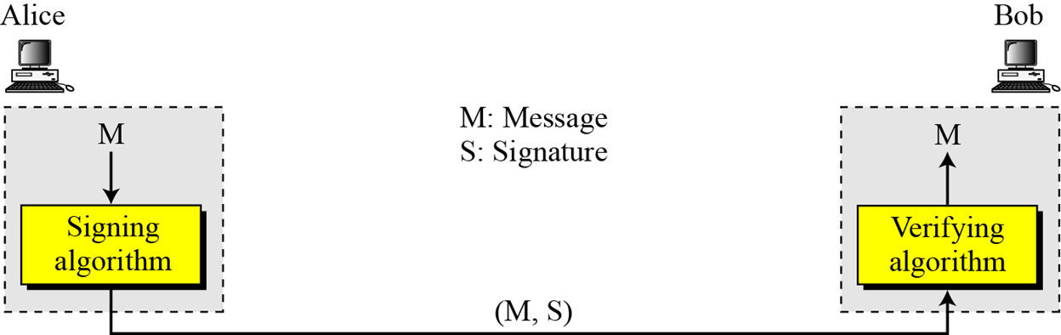
PROCESS

Slide 9
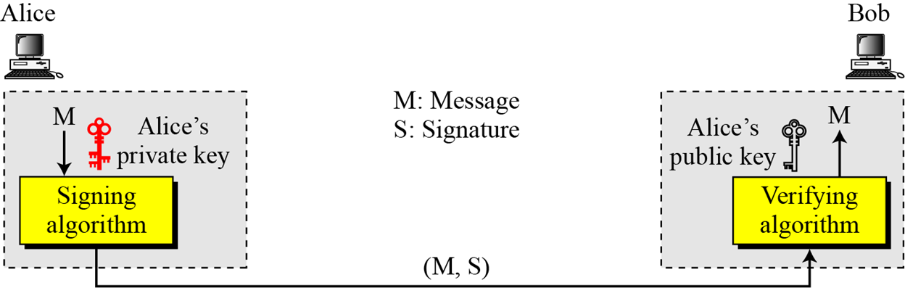
Need for Keys

Slide 10
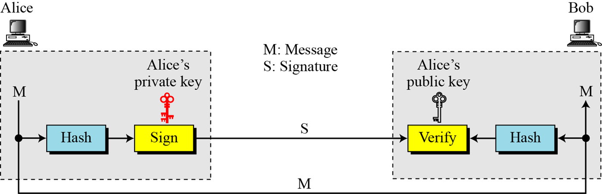
Signing the Digest

Slide 11
SERVICES
Message Authentication
Message Integrity
Nonrepudiation
Confidentiality

Slide 12
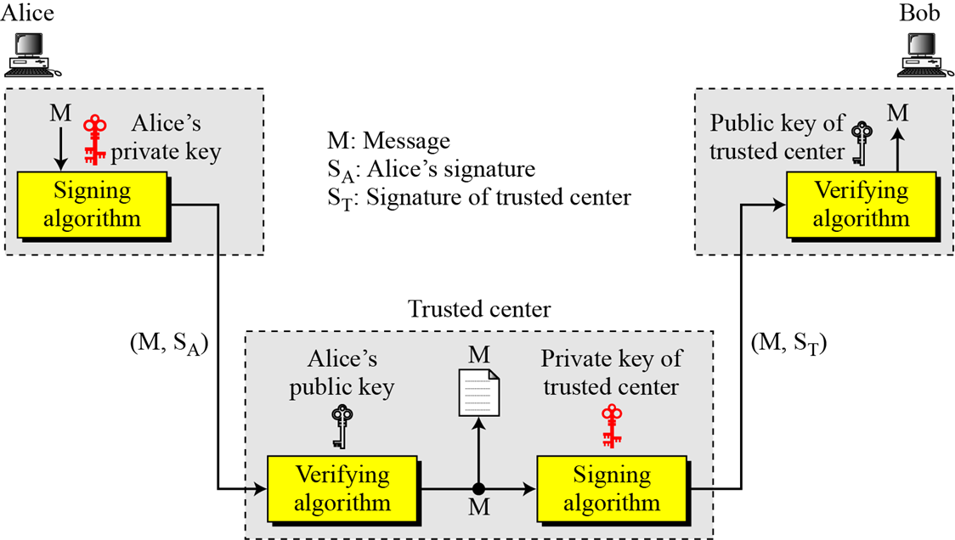
Using a trusted center for nonrepudiation

Slide 13
ATTACKS ON DIGITAL SIGNATURE
Key-Only Attack
Known-Message Attack
Chosen-Message Attack

Slide 14
Forgery Types
Existential Forgery
Selective Forgery

Slide 15
DIGITAL SIGNATURE SCHEMES
RSA Digital Signature Scheme
ElGamal Digital Signature Scheme
Schnorr Digital Signature Scheme
Digital Signature Standard (DSS)
Elliptic Curve Digital Signature Scheme

Slide 16
Digital signature process steps
Key generation
Signing
verification

Slide 17
Thank You!
Next Class
Mandatory reading for the next class
https://tools.ietf.org/html/rfc5485
‹#›

Slide 18


Rajashree S
Computer Science and Engineering
PES University, Bengaluru
10 June 2020
‹#›

